Slide 1
Introduction to Programming

Slide 2
Why this workshop ?
Hosts of the workshop:
The purpose of this workshop is to make people aware of basic programming paradigms and principles, along with some C/C++ examples. After the workshop, you will be able to write small programs and build simple logic using programming languages.
Samriddha Chattopadhyay
Sadock Chakma
Keshav Naram
Samir Girupanje
Varendra Maurya

Slide 3
Agenda
Basic programming paradigms.
Variables and Data Types
Operators
Conditionals
Loops
Functions
Examples from C++
Variables and Data Types
Operators
Conditionals
Loops
Functions
Q/A
Practice Problems

Slide 4
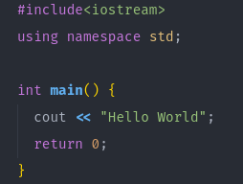
Basic programming paradigms
There are some constructs that are widely used in all programming languages.
First, we will see a very basic example of a program.
This will output
Hello World
in the terminal

Slide 5
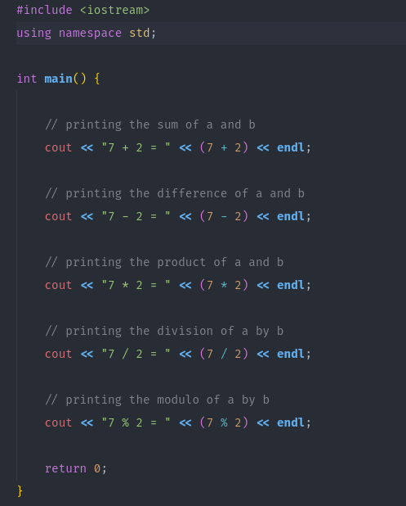
Operators
Some of the widely used Operators:
Addition (+)
Subtraction (-)
Multiplication (*)
Division (/)
Modulus(%)
Assign (=)
Equality (==)
Inequality (!=)
Increment (++)
Increment and assign (+=)
Decrement (--)
Decrement and assign (-=)
More on https://www.programiz.com/cpp-programming/operators

Slide 6
Variables
Variable is a region of memory for holding a single piece of data.

Slide 7
Variables
Variable is a region of memory for holding a single piece of data.

Slide 8
Variables
Variable is a region of memory for holding a single piece of data.

Slide 9
Identifiers
An identifier is used to name variables and other entities. An identifier can consist of letters, digits, and underscore character(“_”).

Slide 10
Identifiers
An identifier is used to name variables and other entities. An identifier can consist of letters, digits, and underscore character(“_”).
a

Slide 11
Constants
A constant is an identifier whose value doesn’t change

Slide 12
Constants
A constant is an identifier whose value doesn’t change
13
a

Slide 13
Constants
A constant is an identifier whose value doesn’t change
13
a = 5 X
a

Slide 14
Data Types
Data types are used to define the type of data a variable can store.
Integer (int)
Short Integer (short int)
Long integer (long int)
Long Long integer (long long int)
Character (char)
Decimal (double, float)
Long decimal (long double)
All of the above can be signed or unsigned.

Slide 15
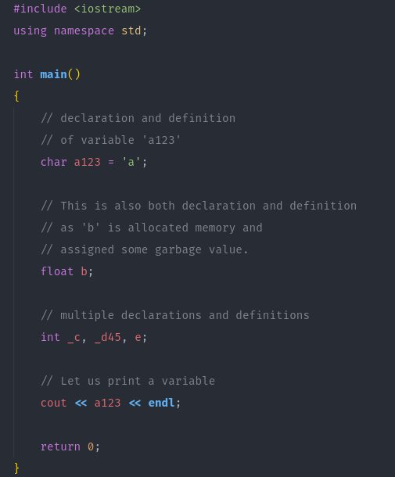
Example

Slide 16
Conditionals
If
Condition
If
Do Something

Slide 17
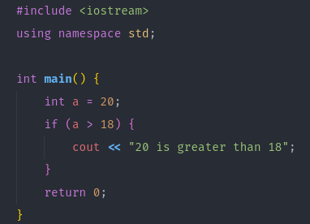
Example

Slide 18
Conditionals
2. Else
Condition
Do Something Else
If
Else
Do Something

Slide 19
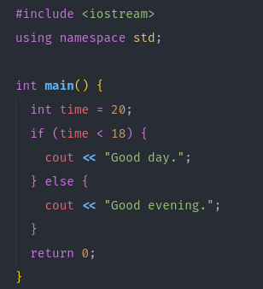
Example

Slide 20
Conditionals
3. Else if
Condition
Do Something Else if the first condition is false
Do Something Else
If
Another Condition
Else
Else If
Do Something

Slide 21
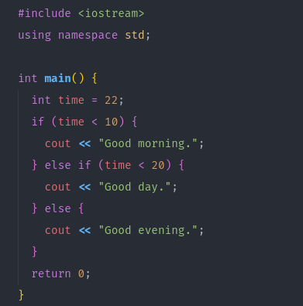
Example

Slide 22
Loops
While
Condition
While true
Do Something

Slide 23
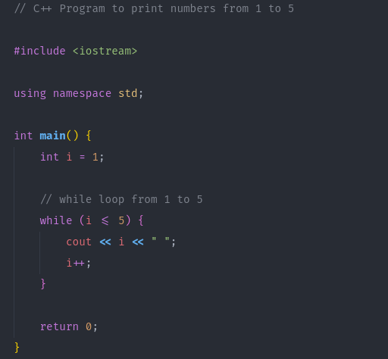
Example

Slide 24
Loops
2. For

Slide 25
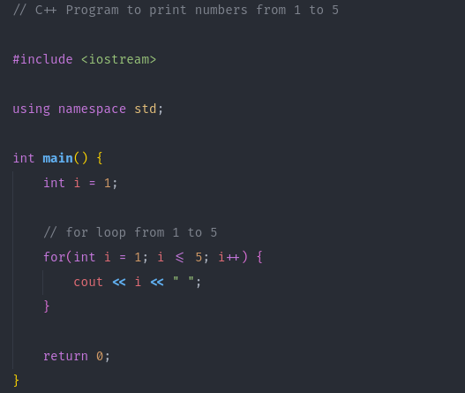
Loops
2. For

Slide 26
Functions
A function is a block of code which only runs when it is called.

Slide 27
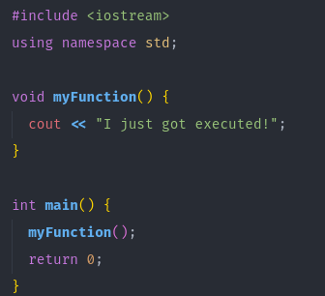
Functions
A function is a block of code which only runs when it is called.

Slide 28
Recursion
A function calling itself is a recursion

Slide 29
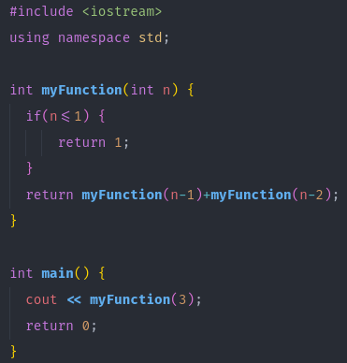
Recursion
A function calling itself is a recursion

